Slide 1
BLISS- Blended Learning Implementation for reSilient, acceSsible and efficient higher education
UNILJ – Unit 1 PID Control
Disclaimer: Funded by the European Union. Views and opinions expressed are however those of the author(s) only and do not necessarily reflect those of the European Union or the European Education and Culture Executive Agency (EACEA). Neither the European Union nor EACEA can be held responsible for them.

Slide 2
Agenda
Unit Overview
Constructive Alignment:
ILOs
Schedule & Activity Flow for TAs and ATs
Course Content

Slide 3
Unit Overview
Mother Course: Discrete Control Systems (5 ECTS)
Mother Programme: Master in Mechanical Engineering (Year 1)

Slide 4
Unit Overview
Study-unit Aims: This study-unit aims to give the students a knowledge of programming a discrete PID controller. The lectures begins with an introduction of a classical (analog) PID and its realization and ends with a discrete version of the PID. In this way the students can fully appreciate the advantages of discrete (digital) controllers.

Slide 5
Unit Overview
Course Topic: PID control
Blended Learning: Inclass lectures + Additional online material (obligatory)

Slide 6
Constructive Alignment: ILOs
ILO1 - Program a discrete version of the PID control algorithm on an Arduino microcontroller and analyze the stability of the close loop system.

Slide 7
Constructive Alignment: TAs + ATs
Week 1
Week 2
Week 3
Part 1
Part 2
Part 3
In class Lectures are provided to learn theoretical background of Control Systems
TA 1.1
AT 1.1
In Class Lectures are provided to learn theoretical background of stability and analog PID
TA 1.2
AT 1.2
In Class Realization
of analog and discrete
PID and z-transform
TA 1.3
AT 1.3

Slide 8
Part 1
Week 1
Week 2
Week 3
Part 1
Part 2
Part 3
ILO reference (Highlight the Verb) | Teaching Activity (What the teachers do) | Learning Activity (What the students do)
ILO 1 Program a discrete version of the PID control algorithm on an Arduino microcontroller and analyze the stability of the close loop system. | TA 1.1 The teacher presents theoretical background of control systems and hands out self-assessment questionnaires. | LA 1.1 Students write notes and fulfill self-assessment questionnaires (online; 10 minutes with prompt feedback)

Slide 9
Part 1
Week 1
Week 2
Week 3
Part 1
Part 2
Part 3
Supporting Materials:
ICCT – Interactive Course for Control Theory (previous Erasmus+ project)
Online Questionnaire
A ppt of the lectures is provided for reference and future revision.
Supporting equipment: None
Supporting facilities: Lecture room
Instructions:
Students must complete all online materials, including self-assessment questions.
Objective: Ensure students understand the theoretical background of Control Theory

Slide 10
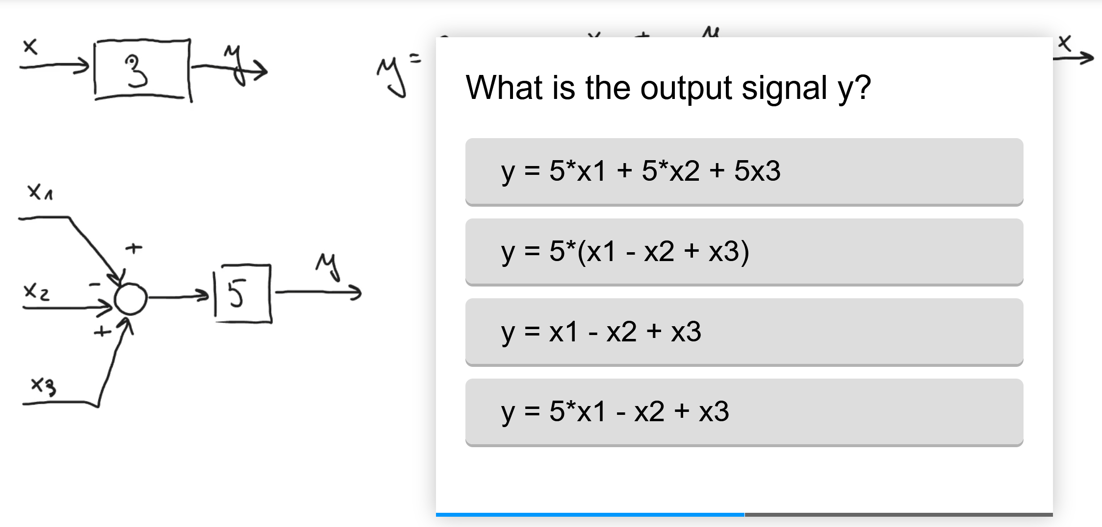
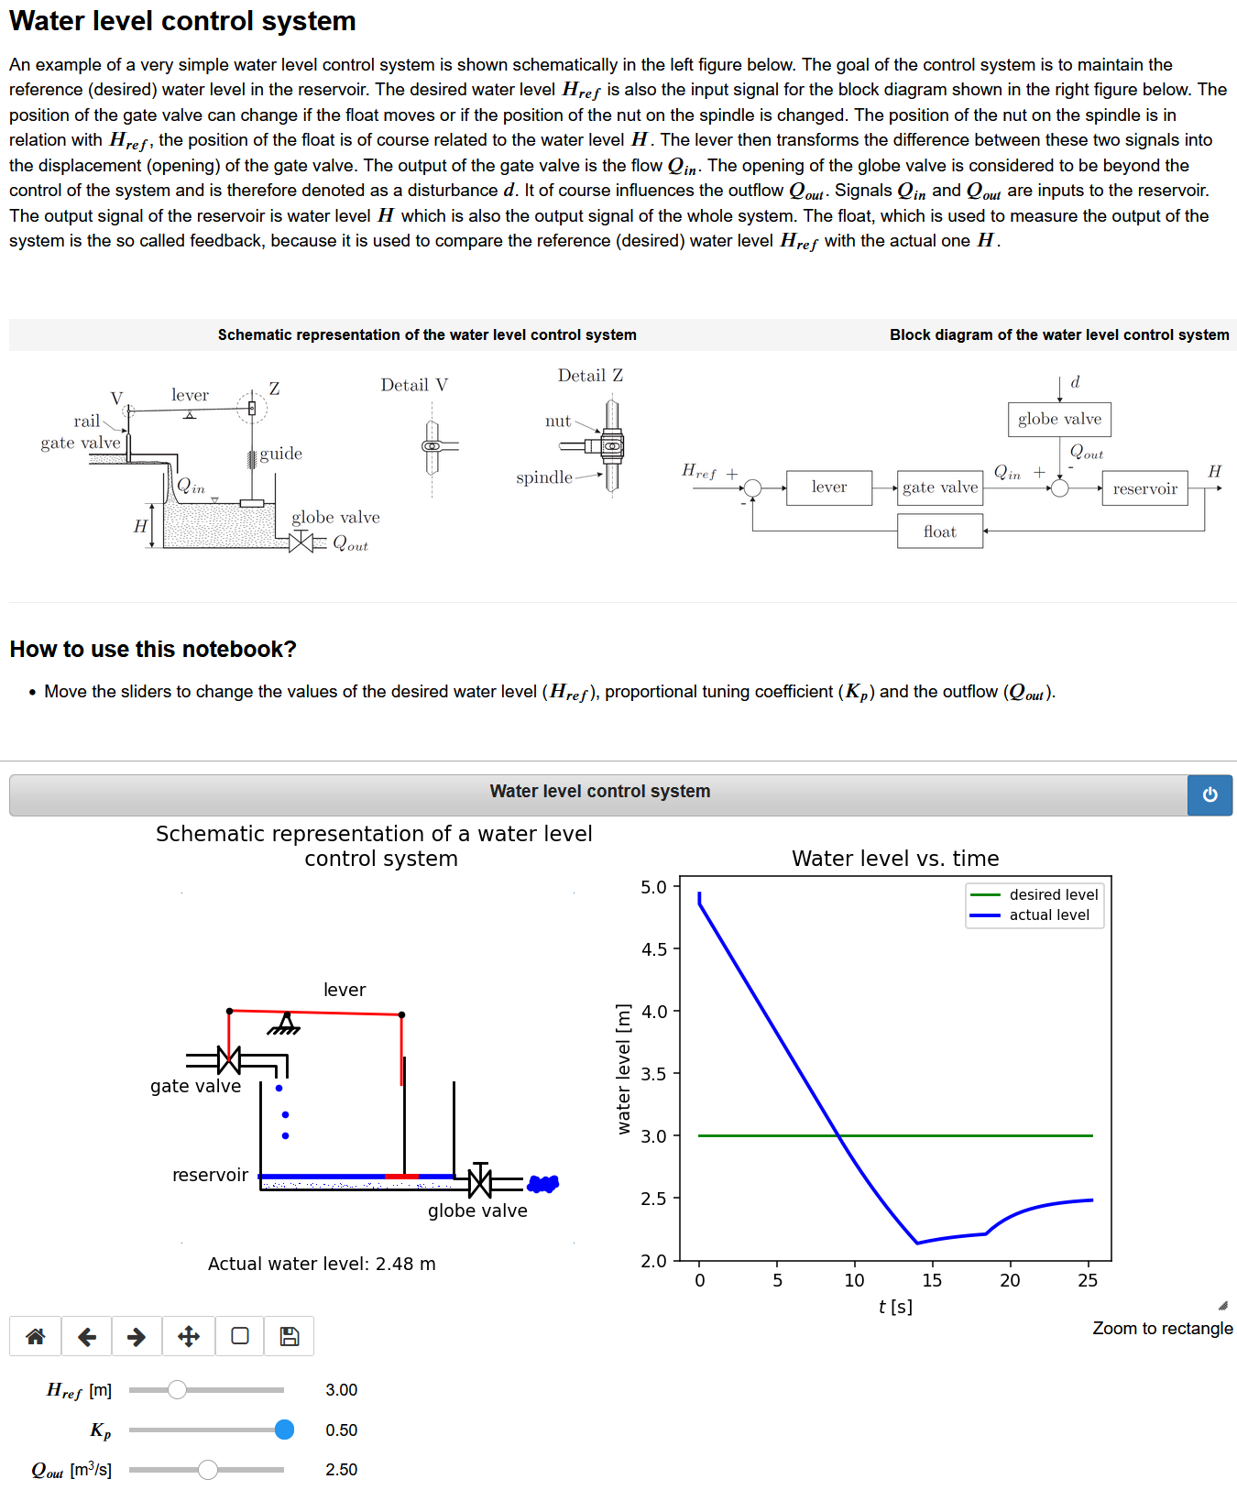
Part 1 - Materials

Slide 11
Part 2
Week 1
Week 2
Week 3
Part 1
Part 2
Part 3
ILO reference (Highlight the Verb) | Teaching Activity (What the teachers do) | Learning Activity (What the students do)
ILO 1 Program a discrete version of the PID control algorithm on an Arduino microcontroller and analyze the stability of the close loop system. | TA 1.2 The teacher explains (lecture) the concept of stability and introduces criteria for system stability. The teacher presents ICCT-Interactive Course for Control Theory (developed within previous Erasmus+ project). An analog version of PID controller is also introduced. | LA 1.2 Students write notes, use ICCT to gain additional knowledge (interactive examples, self-assessment tasks)

Slide 12
Part 2
Week 1
Week 2
Week 3
Part 1
Part 2
Part 3
Supporting Materials:
ICCT – Interactive Course for Control Theory (previous Erasmus+ project)
Online Questionnaire
A ppt of the lectures is provided for reference and future revision.
Supporting equipment: None
Supporting facilities: Lecture Room
Instructions:
Students must complete all online materials, including self-assessment questions.

Slide 13
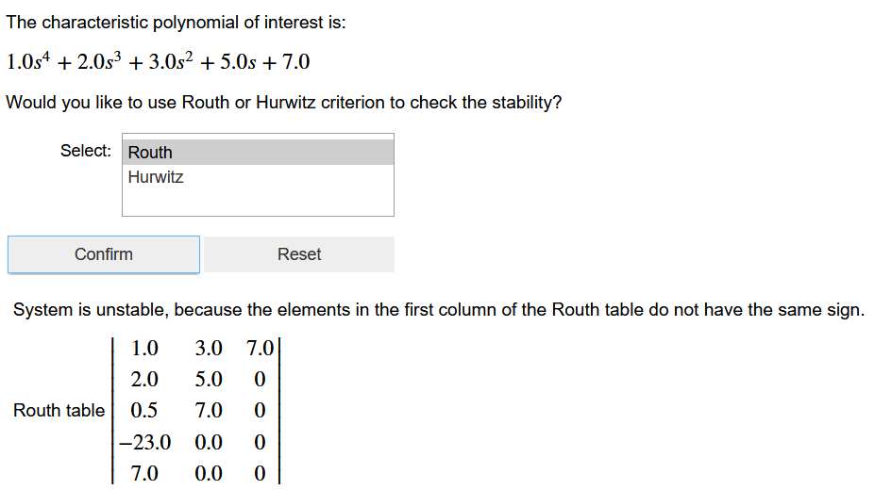
Part 2 - Materials

Slide 14
Part 3
Week 1
Week 2
Week 3
Part 1
Part 2
Part 3
ILO reference (Highlight the Verb) | Teaching Activity (What the teachers do) | Learning Activity (What the students do)
ILO 1 Program a discrete version of the PID control algorithm on an Arduino microcontroller and analyze the stability of the close loop system. | TA 1.3 The teaching assistant introduces z-transform and demonstrates how to program a PID control algorithm on an Arduino microcontroller. | LA 1.3 Students are divided into pairs and program a control algorithm on an Arduino microcontroller.

Slide 15
Part 3
Week 1
Week 2
Week 3
Part 1
Part 2
Part 3
Supporting Materials:
ICCT – Interactive Course for Control Theory (previous Erasmus+ project)
Online Questionnaire
A ppt of the lectures is provided for reference and future revision
Self learning videos
Supporting equipment: Arduino microcontroller and a computer
Supporting facilities: Lecture Room and Laboratory
Instructions: Students will form groups of 2; each pair has to program a PID control algorithm on an Arduino microcontroller.

Slide 16
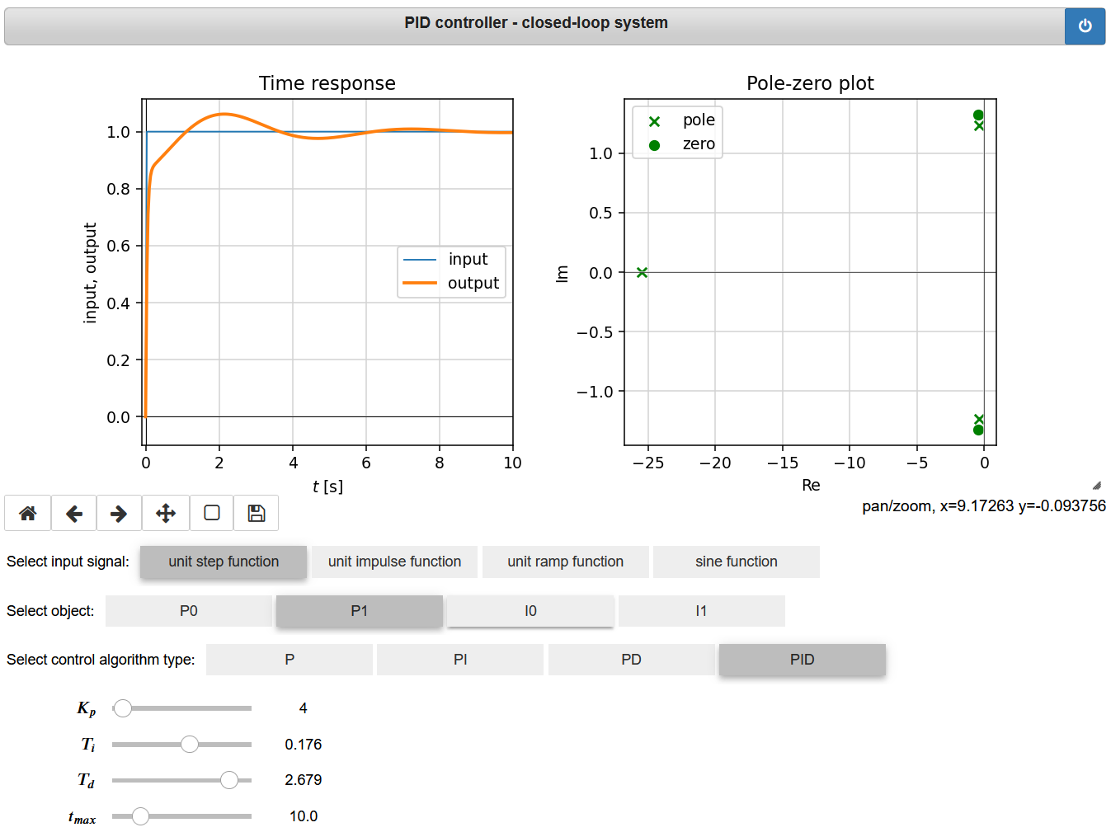
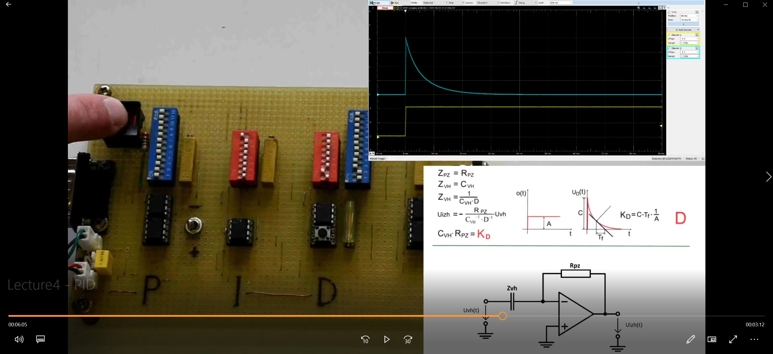
Part 3 - Materials

